Slide 1
Heap

Slide 2



Slide 3
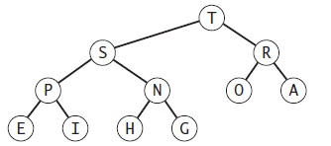
Binary Heap
Satisfies the heap order property
The binary heap is a data structure that can efficiently support the basic priority-queue operations.

Slide 4
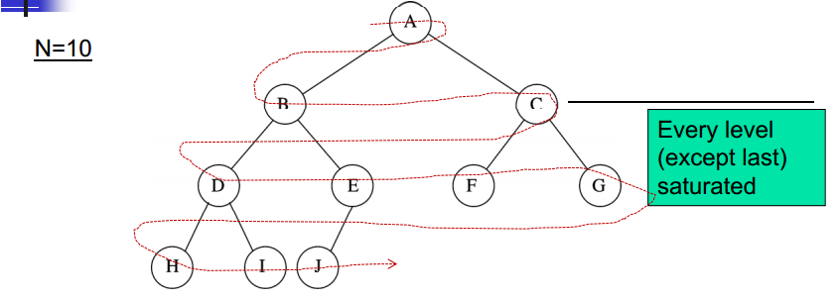
It is Complete: the tree is completely filled except possibly the bottom level, which is filled from left to right.
Height of a complete binary tree with N elements is log base(2) N

Slide 5
A binary heap is a complete binary tree which satisfies the heap ordering property. The ordering can be one of two types:
the min-heap property: the value of each node is greater than or equal to the value of its parent, with the minimum-value element at the root.
the max-heap property: the value of each node is less than or equal to the value of its parent, with the maximum-value element at the root.

Slide 6
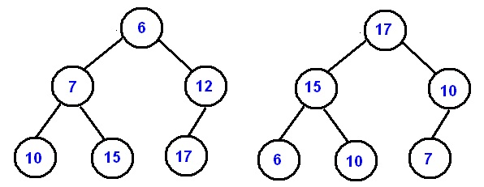

Slide 7
Keys in nodes
Parents keys no smaller than children’s keys (the max-heap property)
So root is the largest key

Slide 8
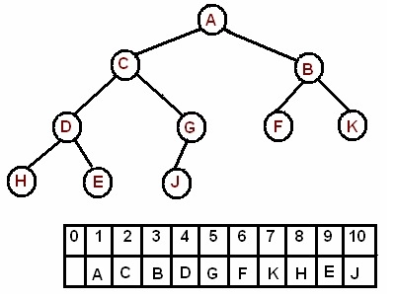
Binary tree in an Array
1
2
3
4
5
6
7
8
9
10
The root is the second item in the array. We skip the index zero cell of the array for the convenience of implementation. Consider k-th element of the array, the
its left child is located at 2 * k index
its right child is located at 2 * k+1. index
its parent is located at k/2 index

Slide 9
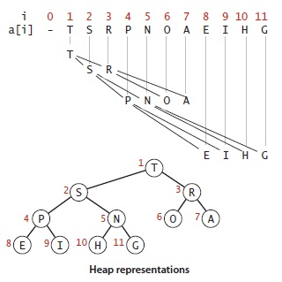

Slide 10
Traversing the heap
We can travel up and down by doing simple arithmetic on array indices: to move up the tree from a[k] we set k to k/2; to move down the tree we set k to 2*k or 2*k+1.

Slide 11
Reheapifying, or restoring heap order.
If heap condition is violated, we travel through the heap, modifying and fixing the violations.
Bottom-up reheapify (Swim)
Top-down reheapify (Sink)

Slide 12
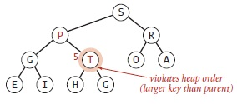
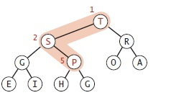
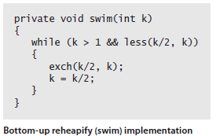
Bottom-up reheapify (Swim)
A node’s key becomes larger than that node’s parent’s key. (A new node is added at the bottom of a heap).
1. We move the node ‘T’ up the heap and exchange it with its parent ‘P’.
2. Even after exchanging it with ‘P’, the heap is still not correct because ‘T’ is still larger than ‘S’, so we exchange ‘T’ once more with its parent ‘S’.

Slide 13
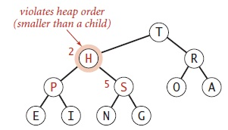
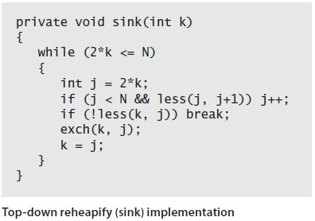
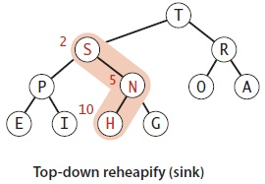
Top-down reheapify (Sink)
If heap order is violated so that parent is smaller than one or both children. (If we replace the node at the root with a new node that has a smaller key).
We exchange the node with the larger of its two children. (H with S).
Since ‘H’ will still be smaller than ‘N’, we will exchange it again.

Slide 14
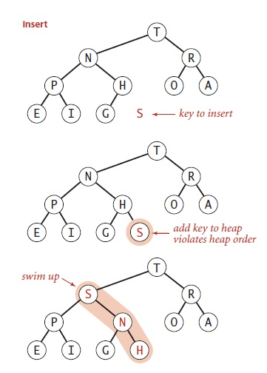
Inserting a New Item in the heap
Add the new item at the end.
Increment the size.
Swim up with the new item until we find the right place for it.

Slide 15
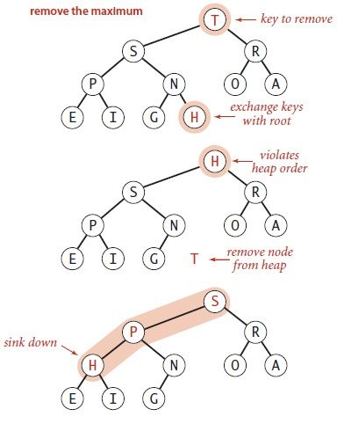
Removing the maximum
Maximum would be at the root, so we exchange it with the last.
Decrement the size of the heap.
Use sink to move key to correct
position.

Slide 16
Complexity
?

Slide 17
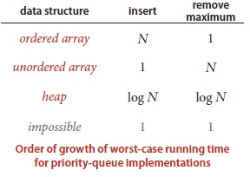
Priority Qs and Binary Heaps
A binary heap will allow us both enqueue and dequeue items in O(logn).
Or O(h)?

